Slide 1

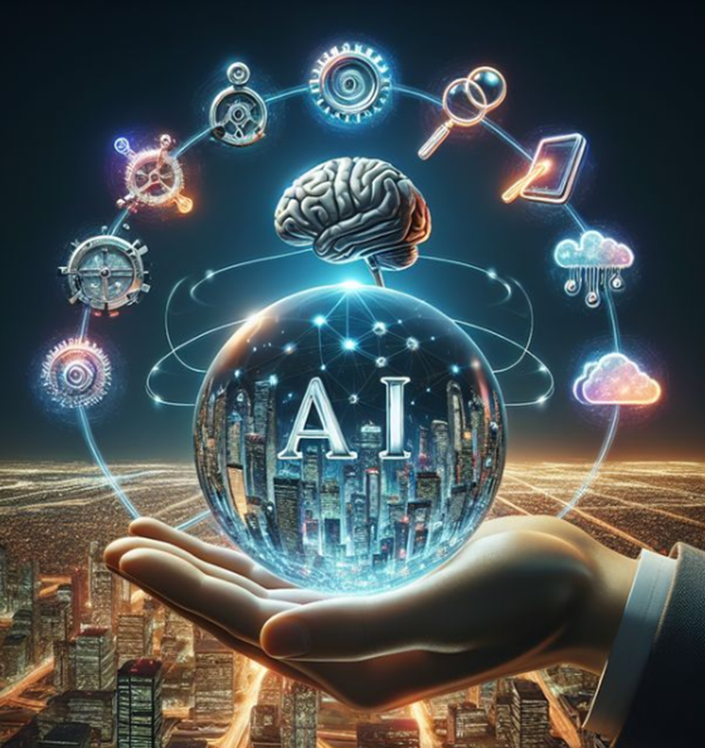
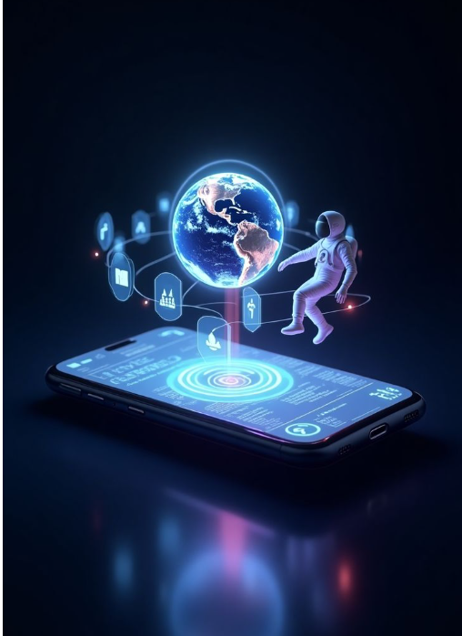
Delhi Public School, Ranipur welcomes you to Technovation 3.0
Innovation is the ability to see change as an opportunity — not a threat."
— Steve Jobs
"AI will not replace humans. But humans with AI will replace humans without AI."
— Unknown
Code the Future,
Connect the World!”
"Any sufficiently advanced technology is indistinguishable from magic." — Arthur C. Clarke

Slide 2
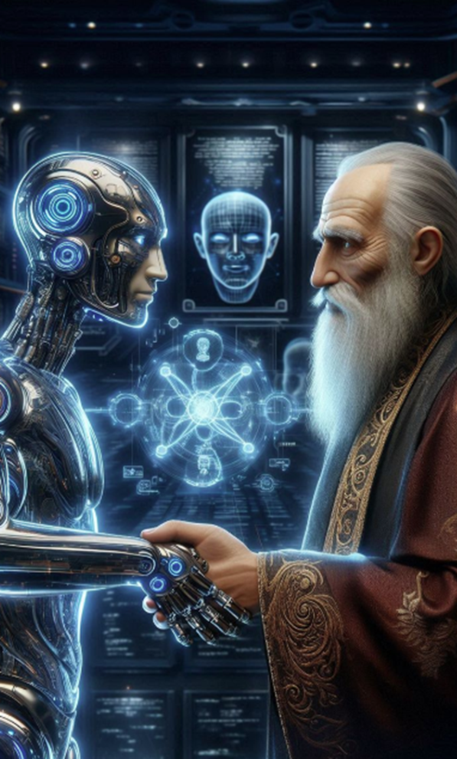
Delhi Public School, Ranipur welcomes you to Technovation 3.0
Code the Future,
Connect the World!”
"AI will not replace humans. But humans with AI will replace humans without AI."
— Unknown
"The coming era of AI is not one of man versus machine, but rather of man with machine."
— Satya Nadella
"Any sufficiently advanced technology is indistinguishable from magic." — Arthur C. Clarke

Slide 3

Delhi Public School, Ranipur welcomes you to Technovation 3.0
Code the Future,
Connect the World!”
"AI will not replace humans. But humans with AI will replace humans without AI."
— Unknown
"The coming era of AI is not one of man versus machine, but rather of man with machine."
— Satya Nadella
"Any sufficiently advanced technology is indistinguishable from magic." — Arthur C. Clarke

Slide 4
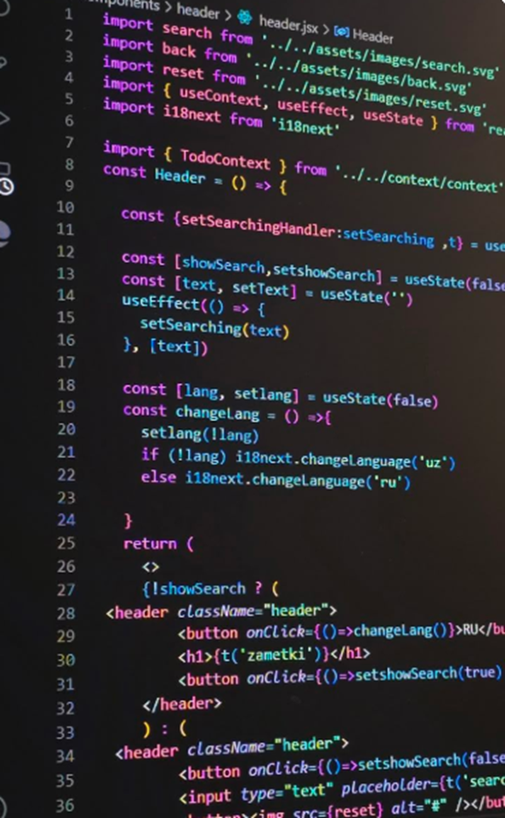
Delhi Public School, Ranipur welcomes you to Technovation 3.0
"The coming era of AI is not one of man versus machine, but rather of man with machine."
— Satya Nadella
Code the Future,
Connect the World!”
"Debugging is twice as hard as writing the code in the first place."
— Brian Kernighan
"Any sufficiently advanced technology is indistinguishable from magic." — Arthur C. Clarke

Slide 5

Delhi Public School, Ranipur welcomes you to Technovation 3.0
"The Internet is becoming the town square for the global village of tomorrow."
— Bill Gates
Code the Future,
Connect the World!”
"Debugging is twice as hard as writing the code in the first place."
— Brian Kernighan
"Any sufficiently advanced technology is indistinguishable from magic." — Arthur C. Clarke

Slide 6
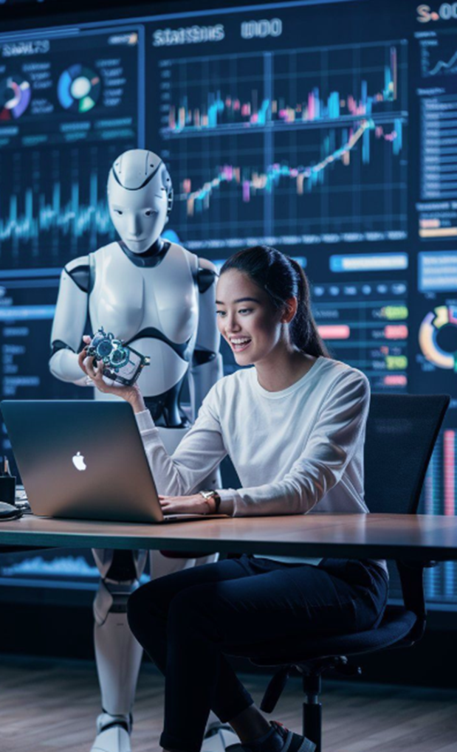
Delhi Public School, Ranipur welcomes you to Technovation 3.0
Code the Future,
Connect the World!”
"The Internet is becoming the town square for the global village of tomorrow."
— Bill Gates
"The Web does not just connect machines, it connects people."
— Tim Berners-Lee
"Debugging is twice as hard as writing the code in the first place."
— Brian Kernighan

Slide 7
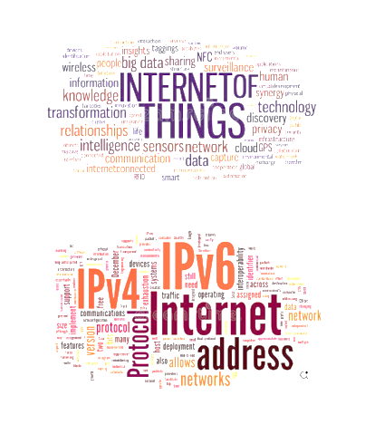
Delhi Public School, Ranipur welcomes you to Technovation 3.0
Code the Future,
Connect the World!”
"The Internet is becoming the town square for the global village of tomorrow."
— Bill Gates
"The Web does not just connect machines, it connects people."
— Tim Berners-Lee
"The great thing about the Internet is that it’s open. The bad thing is that it’s open."
— Esther Dyson

Slide 8
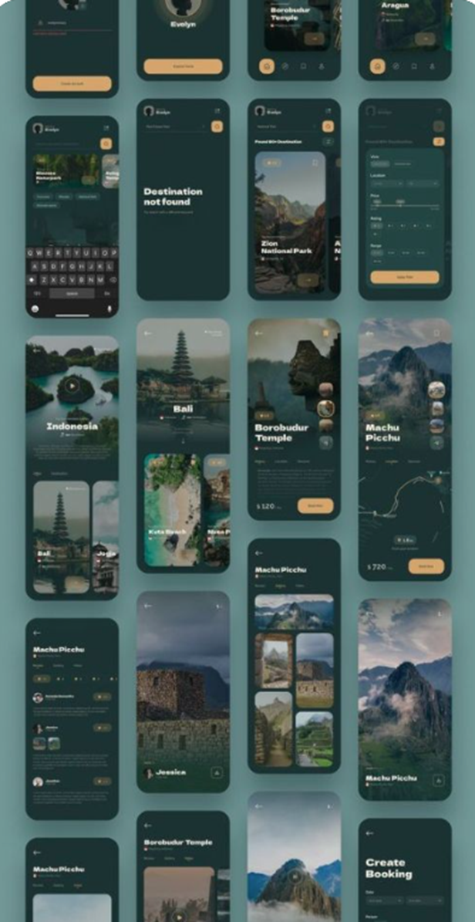
Delhi Public School, Ranipur welcomes you to Technovation 3.0
"The Web does not just connect machines, it connects people."
— Tim Berners-Lee
"The great thing about the Internet is that it’s open. The bad thing is that it’s open."
— Esther Dyson
"Design is not just what it looks like and feels like. Design is how it works."
— Steve Jobs
Code the Future,
Connect the World!”

Slide 9
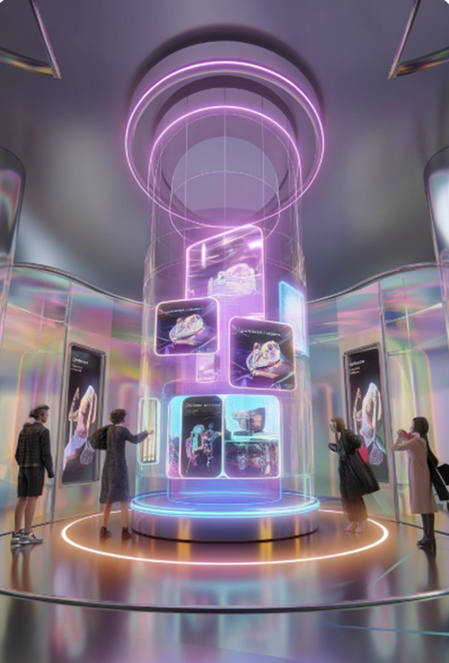
Delhi Public School, Ranipur welcomes you to Technovation 3.0
"If you're not embarrassed by the first version of your product, you’ve launched too late."
— Reid Hoffman
"The great thing about the Internet is that it’s open. The bad thing is that it’s open."
— Esther Dyson
"Design is not just what it looks like and feels like. Design is how it works."
— Steve Jobs
Code the Future,
Connect the World!”

Slide 10
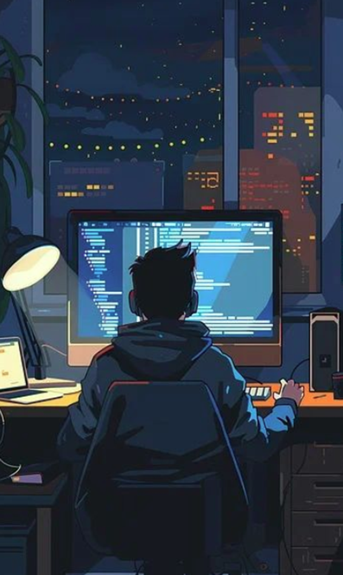
Delhi Public School, Ranipur welcomes you to Technovation 3.0
"If you're not embarrassed by the first version of your product, you’ve launched too late."
— Reid Hoffman
Code the Future,
Connect the World!”
"The most dangerous phrase in software development: 'We’ve always done it this way.'"
— Grace Hopper
"Design is not just what it looks like and feels like. Design is how it works."
— Steve Jobs

Slide 11

Delhi Public School, Ranipur welcomes you to Technovation 3.0
"If you're not embarrassed by the first version of your product, you’ve launched too late."
— Reid Hoffman
Code the Future,
Connect the World!”
"The most dangerous phrase in software development: 'We’ve always done it this way.'"
— Grace Hopper
"Good software, like wine, takes time."
— Joel Spolsky

Slide 12
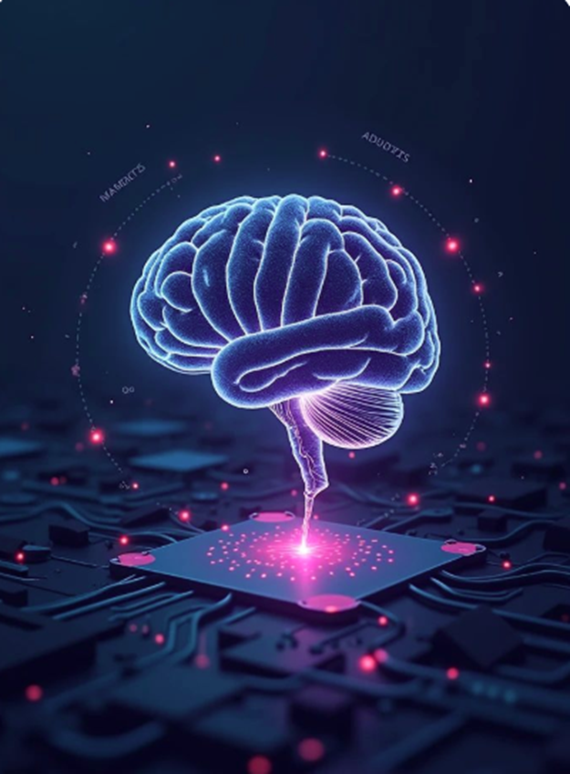
Delhi Public School, Ranipur welcomes you to Technovation 3.0
"The most dangerous phrase in software development: 'We’ve always done it this way.'"
— Grace Hopper
"Good software, like wine, takes time."
— Joel Spolsky
Code the Future,
Connect the World!”
"It’s not about ideas. It’s about making ideas happen."
— Scott Belsky

Slide 13
Delhi Public School, Ranipur welcomes you to Technovation 3.0
"Good software, like wine, takes time."
— Joel Spolsky
Code the Future,
Connect the World!”
"It’s not about ideas. It’s about making ideas happen."
— Scott Belsky
Innovation is the ability to see change as an opportunity — not a threat."
— Steve Jobs

Slide 14
Delhi Public School, Ranipur welcomes you to Technovation 3.0
"It’s not about ideas. It’s about making ideas happen."
— Scott Belsky
Innovation is the ability to see change as an opportunity — not a threat."
— Steve Jobs
Code the Future,
Connect the World!”
"Any sufficiently advanced technology is indistinguishable from magic." — Arthur C. Clarke

